Slide 1
Severe Weather

Slide 2
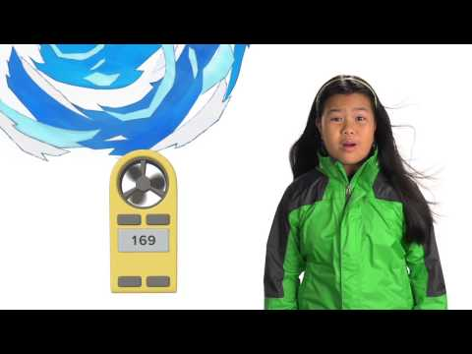
What is Severe Weather? How does it affect us?

Slide 3
How to handle Severe Weather while Camping
THUNDERSTORMS & LIGHTNING
Keep an eye at the sky. Look for darkening skies, flashes of lightning, or increasing winds. Lightning often proceeds rain, so don’t wait for the rain to begin. If you hear the sound of thunder, go to a safe place immediately.
The best place to go is a sturdy building or a car, but make sure the windows in the car are shut. Avoid sheds, picnic areas, baseball dugouts and bleachers.
If there is no shelter around you, stay away from trees. Crouch down in the open area, keeping twice as far away from a tree as far as it is tall. Put your feet together and place your hands over your ears to minimize hearing damage from thunder.
If you’re with a group of people stay about 15 feet from each other.
Stay out of water. It’s a great conductor of electricity. Swimming, wading, snorkeling and scuba diving are not safe. Also, don’t stand in puddles.
Avoid metal. Stay away from clotheslines, fences, and drop your backpacks because they often have metal on them.
If you’re playing an outdoor activity, wait at least 30 minutes after the last observed lightning strike or thunder.

Slide 4
How to handle Severe Weather while Camping
FLOODS
Have a disaster plan.
Prepare a disaster supplies kit for your home and car. Include a first aid kit, canned food, can opener, bottled water, battery-operated radio, flashlight, protective clothing and written instructions on how to turn off electricity, gas, and water.
Move to a safe area quickly.
Move to higher ground, like the highest floor of your home.
Avoid areas subject to sudden flooding like low spots and canyons.
Avoid already flooded areas. If a flowing stream of water is above your ankles stop, turn around and go the other way.
Do not attempt to drive through a flooded road. The depth of the water is not obvious and the road may be washed away.
If your car stalls, leave it and seek higher ground. Rapidly rising water may engulf the car, pick it up and sweep it away.
Kids should never play around high water, storm drains or viaducts.
Be cautious at night, because it’s harder to see flood dangers.
If told to evacuate, do so immediately.

Slide 5
How to handle Severe Weather while Outside
WILDFIRE
PLAN FOR A WILDFIRE:
Have a disaster plan.
Know whether you’re in a wildfire prone area.
Plant fire resistant shrubs and trees around your home.
Have a garden hose that is long enough to reach around your home.
Prepare a disaster supplies kit for your home and car. Include a first aid kit, canned food and a can opener, bottled water, battery-operated radio, flashlight, protective clothing and written instructions on how to turn off electricity, gas, and water.

Slide 6
How to handle Severe Weather while Outside
WILDFIRE
DURING A WILDFIRE:
If you’re advised to evacuate then do so immediately.
Wear protective clothing.
Lock your home.
Tell someone you left and where you are going.
Choose a safe route away from fire hazards. Watch for changes in the speed and direction of fire and smoke.
AFTER A WILDFIRE:
Stay away from wildfire areas until it is safe.

